Slide 1
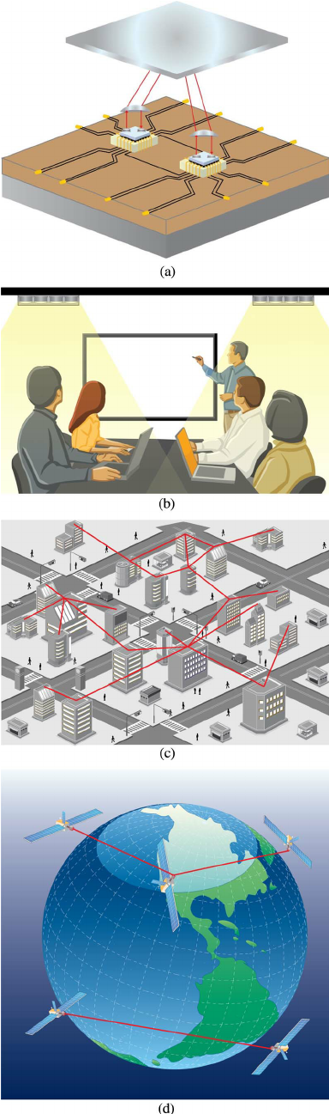
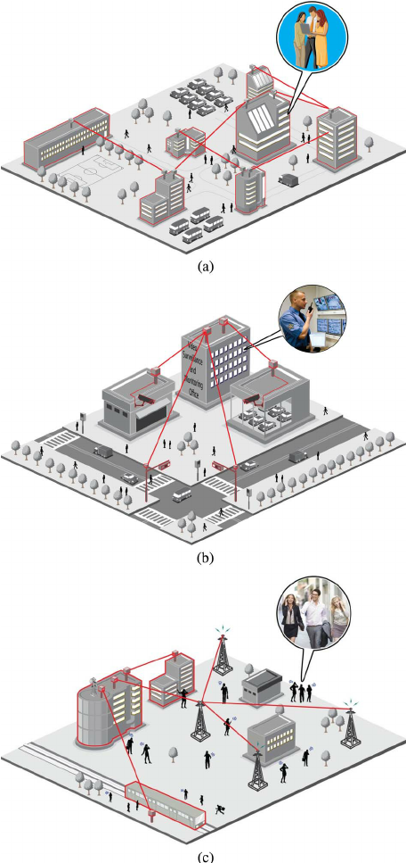
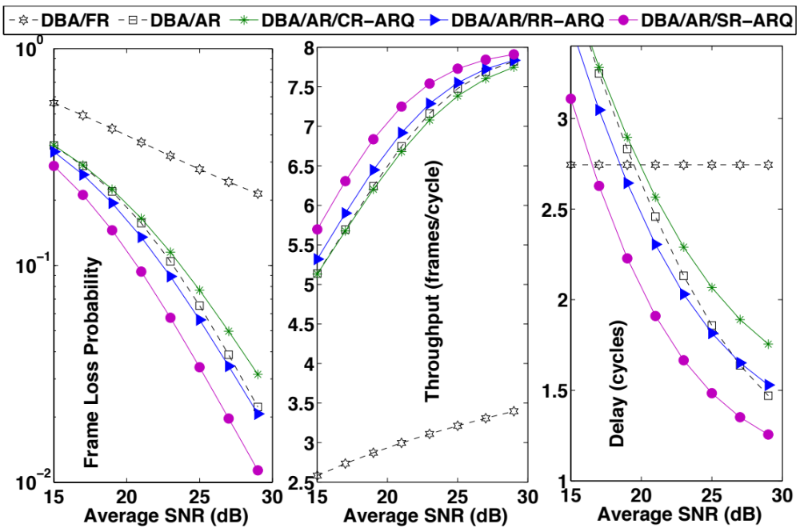
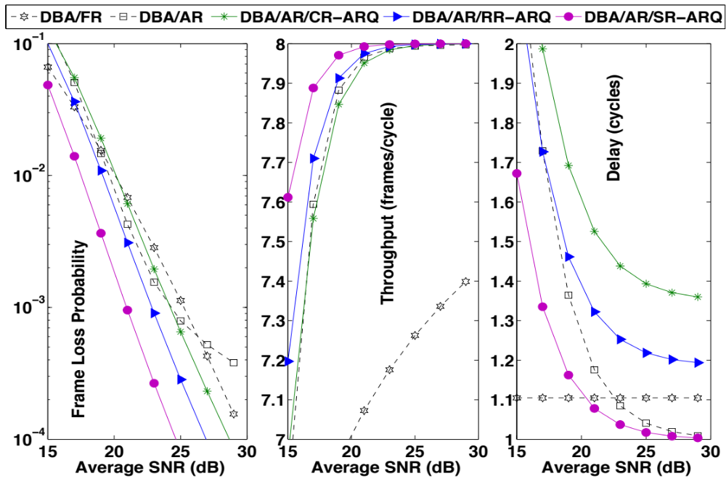



Poster ID: 21
Vuong V. Mai, 3rd Year Ph. D Student
Computer Communications Lab., The University of Aizu
Poster Session at Graduate School Information Fair
Cross-layer Design, Analysis and Optimization
for Optical Wireless Communication (OWC)
General Background
Applications
Definition
OWC is a form of optical communication in which unguided visible, infrared (IR), or ultraviolet (UV) light is used to carry a signal
Fig. 1. Some OWC applications categorized with respect to transmission range. (a) Inter-chip connection, (b) Visible light communication for indoor wireless access, (c) Inter-building connections, (d) Inter-satellite links [1]
Advantages
Quick deployment, Cost-effectiveness, High data rate
Fig. 2. Some typical applications of FSO: (a) An envisioned campus connectivity scenario where inter-building connections are enabled by high data rate FSO links. (b) High quality video surveillance and monitoring of a city can be made possible by FSO links. (c) FSO links provide backhaul for cellular systems. These are particularly useful for cases where fiber optic installment is expensive or difficult to deploy [1]
Classifications
Outdoor: Free-space optical communication (FSO)
Indoor: Visible Light Communication (VLC)
Topologies: p2p, relaying; hybrid FSO/RF, hybrid FSO/PON,
hybrid VLC/Wifi
Fig. 1.
Fig. 2
Cross-layer Design, Analysis and Optimization for OWC
Research Challenges
The optical power launched from the transmitter is affected by various factors before arriving at the receiver. These include system loss, geometric loss, misalignment loss, atmospheric loss, atmospheric turbulence induced fading, and ambient noise. As a result, the traditional method of designing networks using the layered approach might be unsuitable and inefficient for designing OWC networks
Layers & Protocols Considered in My Study
Application layer | VLC Indoor Positioning System
Transport layer | Performance Analysis of Transmission Control Protocol (TCP) over FSO, VLC
Network layer | Possibilities of Integrating OWC in Existing Networks & Technologies Hybrid FSO/RF Networks Integrated FSO/PON Networks Hybrid VLC/Wifi Networks
Link layer | New designs for media access control (MAC) protocols in the integrated networks Dynamic bandwidth allocation (DBA) for Integrated FSO/PON networks Joint IEEE 802.15.7 and IEEE 802.11 CSMA/CA(s) for Hybrid VLC/Wifi Networks Applications of Automatic-repeat-request (ARQ) protocols for reliable transmissions
Physical layer | Applications of Adaptive-rate (AR) schemes for effective transmissions
My Approaches
Cross-layer design is an emerging methodology, which can help to improve and optimize the performance of system by exploiting the interactions between the various protocols/layers. In my graduate research project, I study Cross-layer Design, Analysis and Optimization approaches to improve the performance of OWC networks
A Case of Study: Protocol Stack Design and Analysis for Integrated FSO/PON
FTP server
Curb
Home
HTTP server
FSO link
ONU 1
Home
Without Adaptive Rate
Email server
FSO link
ONU 2
Home
Video server
OLT
FSO link
Cellular
4G, 5G
With Adaptive Rate
Fiber
Optical
distribution
network
WiMAX
Voice server
WiFi
Metro/Core
ONU N
Heterogeneous
access networks
Without ARQ
Traditional PON
Integrated FSO/PON
New MAC
Designs_2 [5]
With ARQ
FBA/DBA
FSO/PON
concepts [2,3]
New MAC
Designs_1 [4]
ARQ
DLC
Fixed rate
FBA/DBA
DBA
DBA
MAC
Fixed rate
AR
AR
PHY
Adaptive Rate
controller
CSI
ACKs/NACKs
Fiber
Fiber & FSO
Fiber & FSO
Fiber & FSO
ARQ controller
Channel
estimator
ARQ controller
Selected rate
CSI
OLT
[1] M. A. Khalighi and M. Uysal, "Survey on Free Space Optical Communication: A Communication Theory Perspective," in IEEE Communications Surveys & Tutorials, vol. 16, no. 4, pp. 2231-2258, Fourthquarter 2014.
[2] N. Khumancha et al. Energy aware free space optical access network. 2012 International Conference on Fiber Optics and Photonics, pp. 1–3, Dec 2012.
[3] S. Di Bartol et al. Experimental demonstration of a gpon free space optical link for full duplex communications. 2014 Fotonica AEIT Italian Conference on Photonics Technologies, pp. 1–3, May 2014.
[4] Vuong V. Mai et al. Adaptive rate-based MAC Protocols Design and Analysis for Integrated FSO/PON Networks. Proc. IEEE International Conference on Communications (ICC'15), London, UK, June 2015.
[5] Vuong V. Mai and Anh T. Pham. Integrated FSO/PON for Broadband Access Networks: A Comprehensive Protocol Stack Design and Analysis. Proc. IEEE Globecom 2015 (GLOBECOM'15), San Diego, CA, USA, Dec. 2015
Transmitter
Bandwidth requested calculation
BW Req.
(REPORT msg)
DBA algorithm
Receiver
ONU
Uplink BW Grants
(GATE msg)
FSO
Fiber

